Slide 1
Control logic design
Module 6

Slide 2
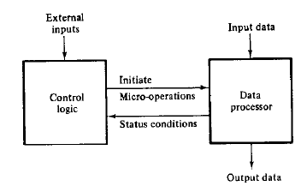
The control logic initiates all microoperations in data processor
To execute instructions, the processor must have some means of generating the control signals needed in the proper sequence
Done using sequential circuit whose internal states dictate the control functions of the system
Ie, at any time, state of sequential control initiates a set of microoperations

Slide 3
Control organization
Hardwired control
One flipflop per stage method (aka Ring counter controller)
Sequence register and decoder method (aka counter decoder method)
PLA control
Microprogrammed control

Slide 4
Hard wired control

Slide 5
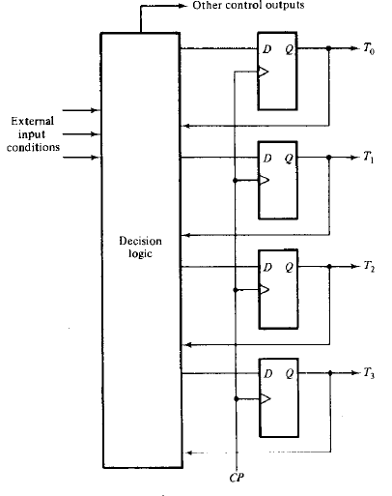
1. One flip flop per stage
One flip flop set at a time
Single bit propagates under the control of design logic
Each represents a state
Transition: function of
input and present Ti.

Slide 6
Example[Hardwired control-example1]
Design carried out with 5 steps:
Problem statement
Initial equipment configuration
Algorithm formulation
Data processor part specification
Design of control logic
Problem statement: Addition and subtraction of binary fixed point numbers, negative numbers in sign’s 2 complement form

Slide 7
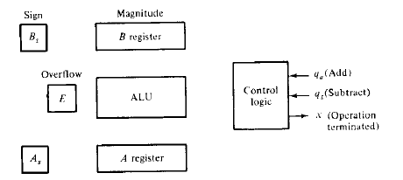
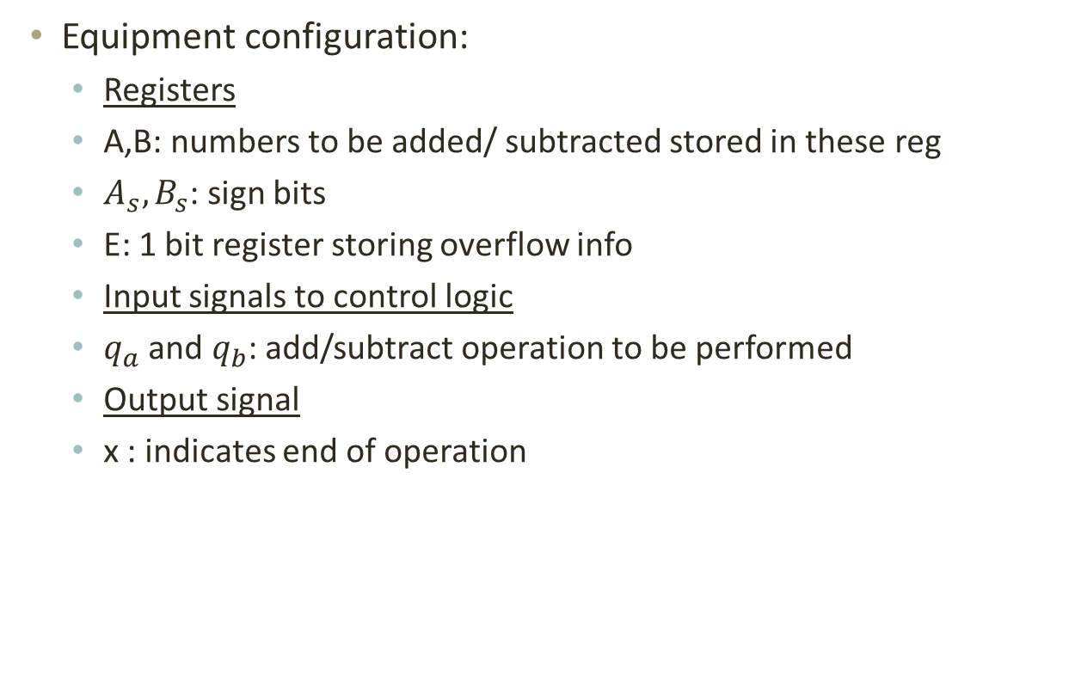
Equipment configuration:
Registers
A,B: numbers to be added/ subtracted stored in these reg
$A_{s},B_{s}$: sign bits
E: 1 bit register storing overflow info
Input signals to control logic
$q_{a}$ and $q_{b}$: add/subtract operation to be performed
Output signal
x : indicates end of operation

Slide 8
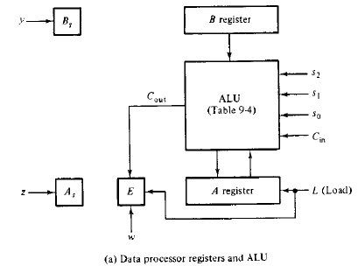
Data processor part specification

Slide 9
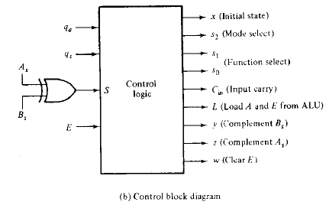

Slide 10
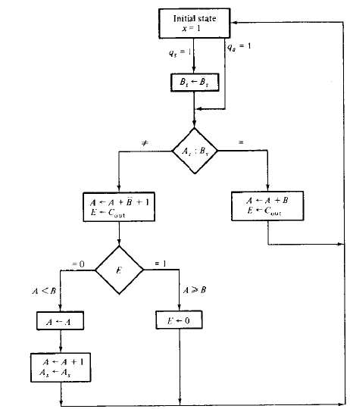
Algorithm:

Slide 11
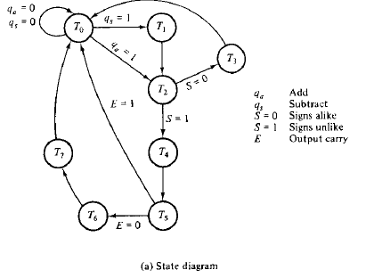
Control state diagram

Slide 12
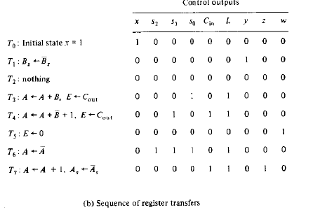

Slide 13
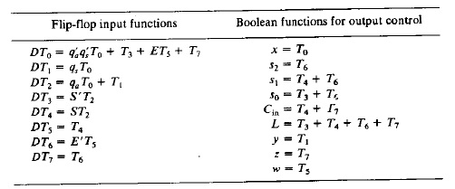
Design of hard wired control
8 states are required as we have seen.
So 8 D flipflops used with the following input functions(implemented in decision logic)
At a time, any of the state will be active and corresponding D flipflop will be activated
The output signals are generated according to the booean function(in table) using OR gate.

Slide 14
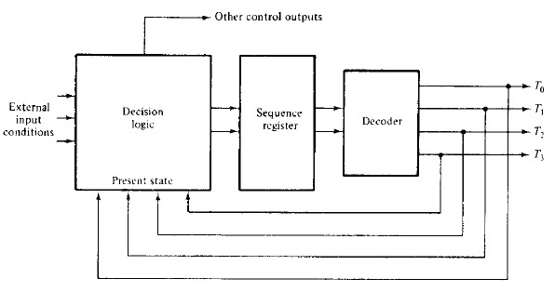
2. Sequence register and decoder method
Register: to sequence control states
Register decoded to provide one output for each state

Slide 15
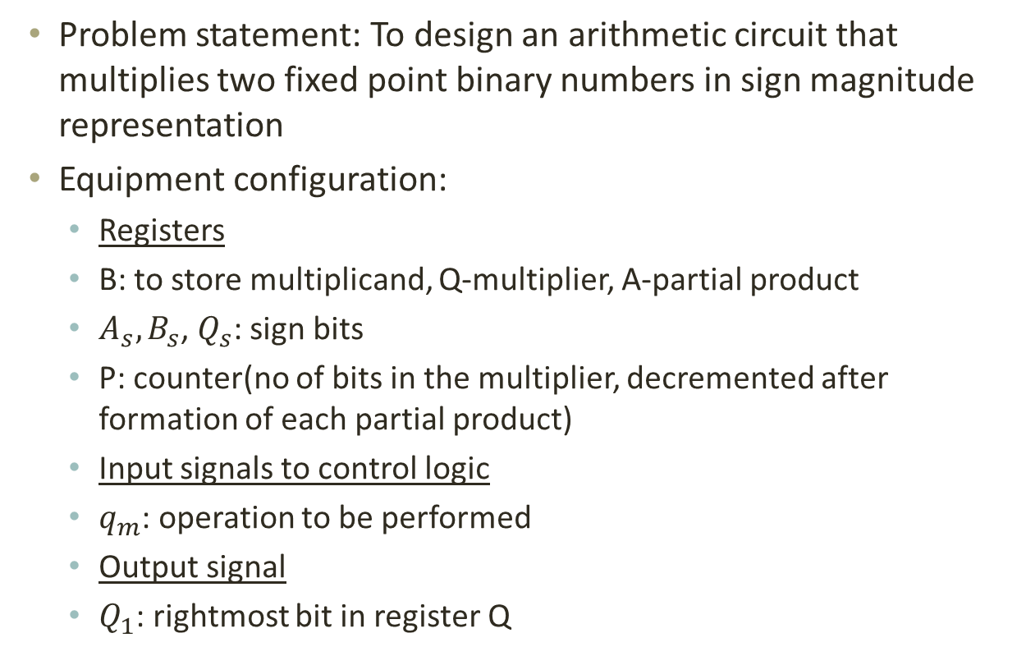
Example[Hardwired control-example2]
Problem statement: To design an arithmetic circuit that multiplies two fixed point binary numbers in sign magnitude representation
Equipment configuration:
Registers
B: to store multiplicand, Q-multiplier, A-partial product
$A_{s},B_{s}$,$Q_{s}$: sign bits
P: counter(no of bits in the multiplier, decremented after formation of each partial product)
Input signals to control logic
$q_{m}$: operation to be performed
Output signal
$Q_{1}$: rightmost bit in register Q

Slide 16
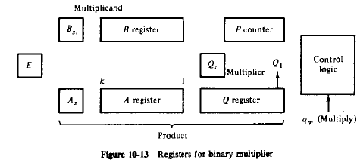

Slide 17
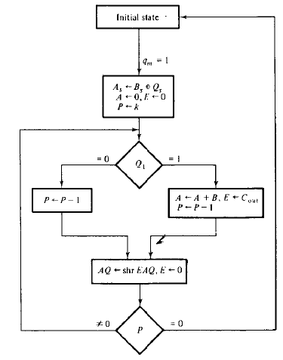

Slide 18
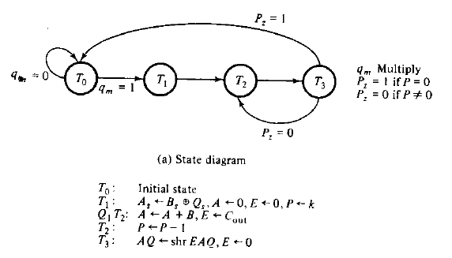

Slide 19
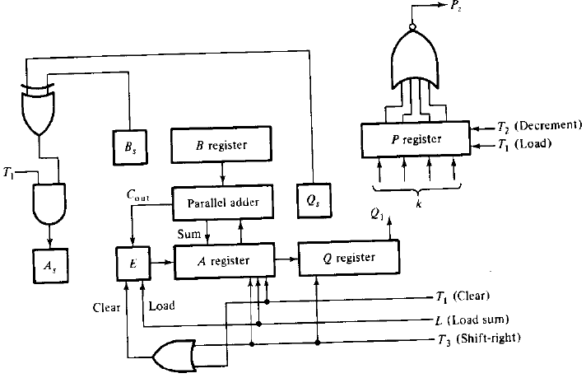
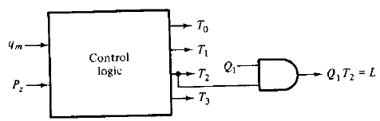
Output from control logic:
T0-indicates that system in initial state
T1-loads sign to As and k into P
T2-decrements P,
If Q=1, L generated- loads A (sum)and E
T3-Shifts A,Q, clears E

Slide 20
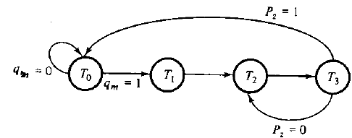
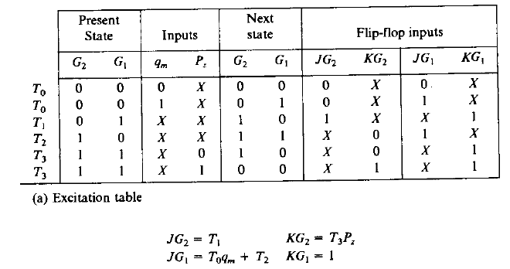
Design of hard wired control
2 JK flipflops and 1 2x4 decoder can be used as there are 4 states

Slide 21
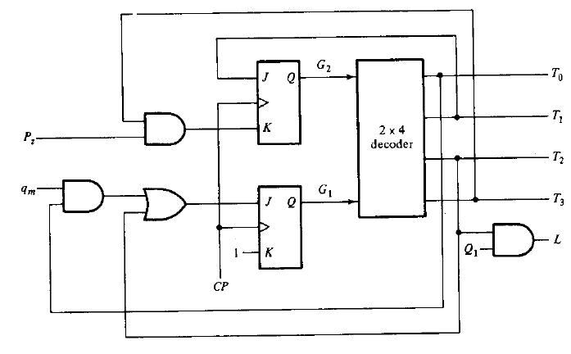

Slide 22
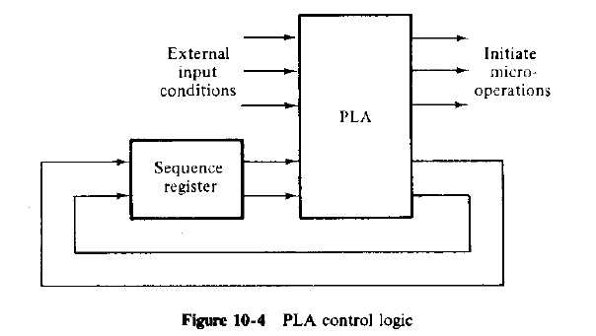
3. Programmable Logic Array
PLA replaces decoder and decision logic circuits
Internal paths inside PLA are programmed according to program table
Similar to sequence register and decoder method, except that all combinational circuits are implemented with PLA

Slide 23
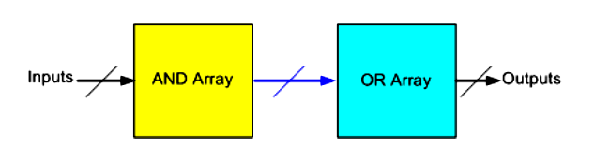
PLA basics
The AND and OR gates inside the PLA are initially fabricated with the links (fuses) among them
The specific Boolean functions are implemented in sum of products form by opening appropriate links and leaving the desired connections.

Slide 24
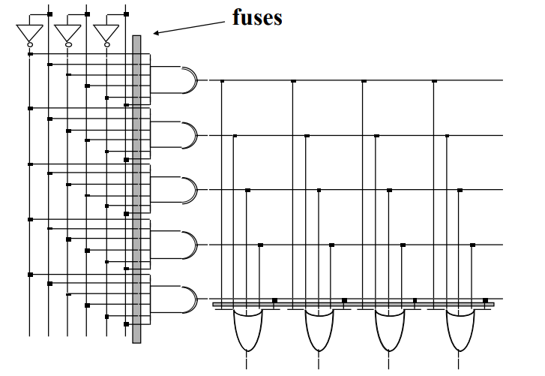

Slide 25
Example(section 10.7)
Design steps:
Obtain state table for controller
(No of states determine the number of flipflops for sequence reg)
Connect PLA to sequence register and to input and output variables
PLA program table obtained from state table

Slide 26
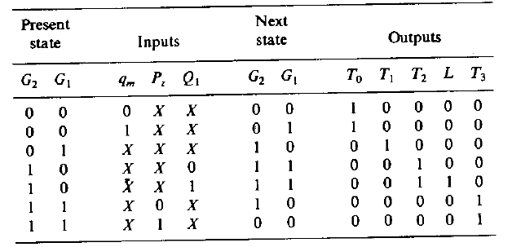
Consider the example of binary multiplier

Slide 27
Output from control logic:
T0-indicates that system in initial state
T1-loads sign to As and k into P
T2-decrements P,
If Q=1, L generated- loads A (sum)and E
T3-Shifts A,Q, clears E

Slide 28
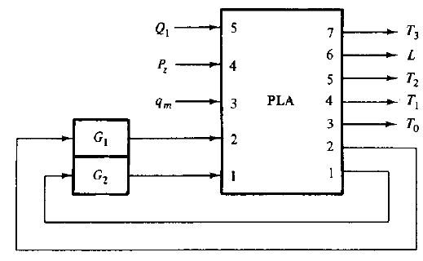
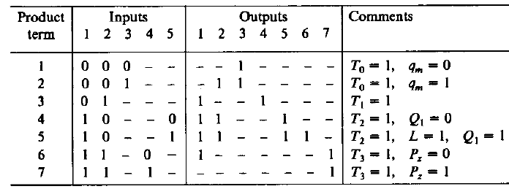
G1 and G2 –flipflops(sequence reg)
Input to PLA- value of present state and 3 ext input

Slide 29
Microprogrammed Control
Control unit initiate a series of sequential steps of microoperations
At any time certain operations are to be initiated and others idle
So represented as series of 1’s and 0’s ->control word
Microprogrammed-> CU whose control variables are stored in memory
Microinstruction
Microprogram
Control memory

Slide 30
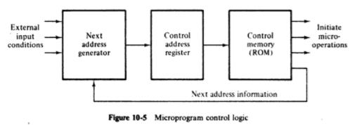

Slide 31
Example(section 10.4)
Problem statement: To design control logic for sign magnitude adder subtractor using microprogram control
State in control memory- address of microinstruction

Slide 32
Control state diagram

Slide 34
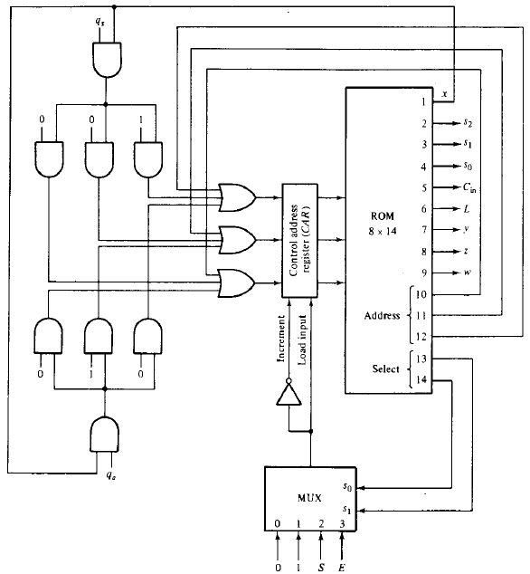

Slide 35
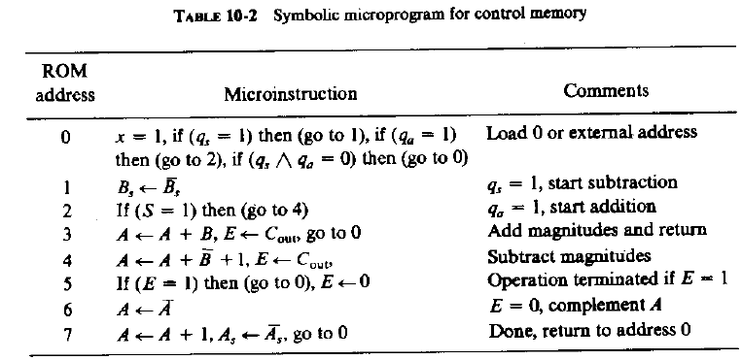

Slide 36
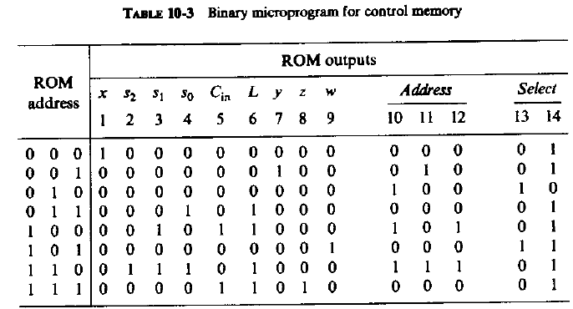

Slide 37
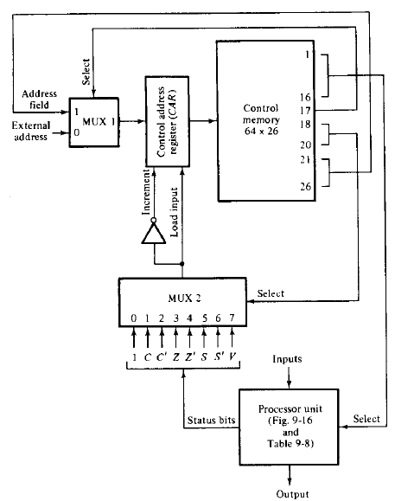
Control of processor unit

Slide 38
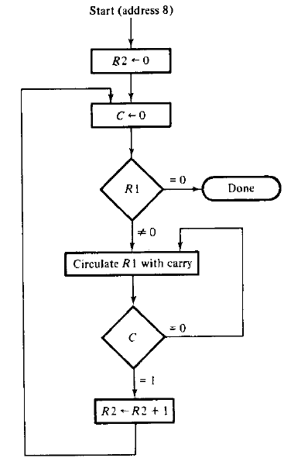
Example2
Problem: counting no of 1’s in register R1
Algorithm:

Slide 39
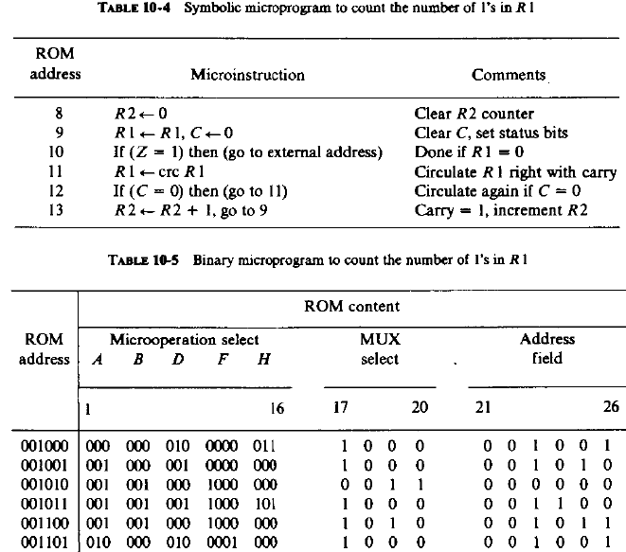

Slide 40
Microprogram sequencer
Microprogram CU control memory
Next address generator
Address generation part- sequencer
Sequencer provide the following capabilities
Increments the present address
Branches to address specified in address field of microinstruction
Branches to address if specified status bit is 1
Transfers to new address specified by external source
Has facility for subroutine calls and return

Slide 41
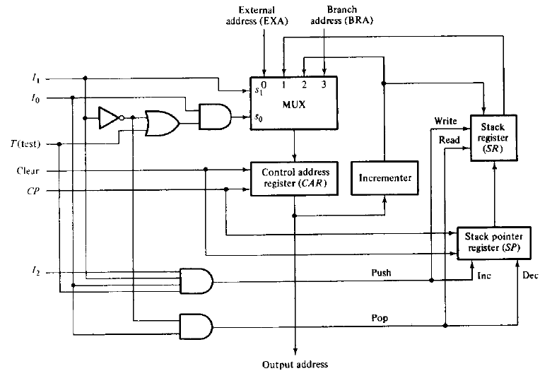
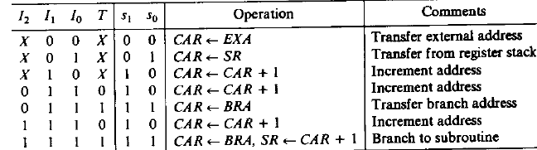

Slide 42
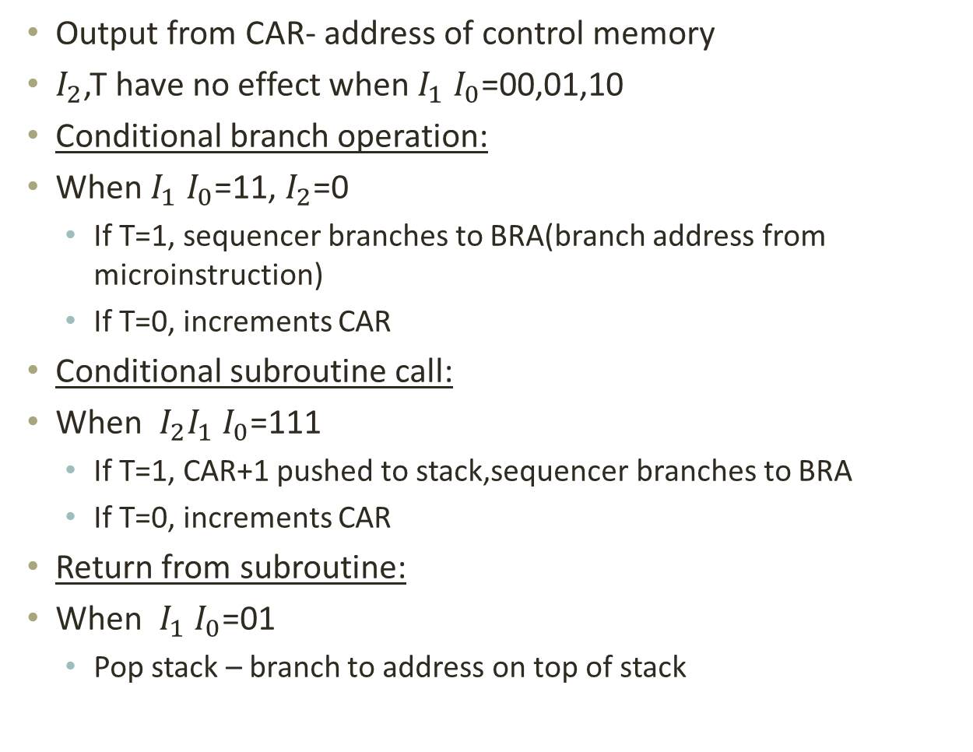
Output from CAR- address of control memory
$I_{2}$,T have no effect when $I_{1}$$I_{0}$=00,01,10
Conditional branch operation:
When $I_{1}$$I_{0}$=11, $I_{2}$=0
If T=1, sequencer branches to BRA(branch address from microinstruction)
If T=0, increments CAR
Conditional subroutine call:
When ${I_{2}I}_{1}$$I_{0}$=111
If T=1, CAR+1 pushed to stack,sequencerbranches to BRA
If T=0, increments CAR
Return from subroutine:
When $I_{1}$$I_{0}$=01
Pop stack – branch to address on top of stack

Slide 43
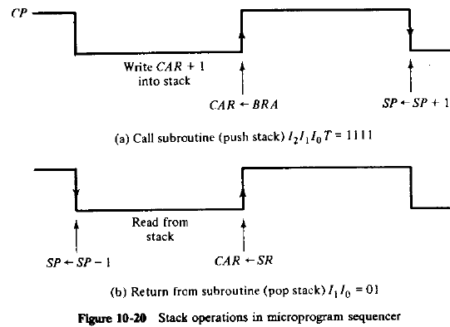

Slide 44
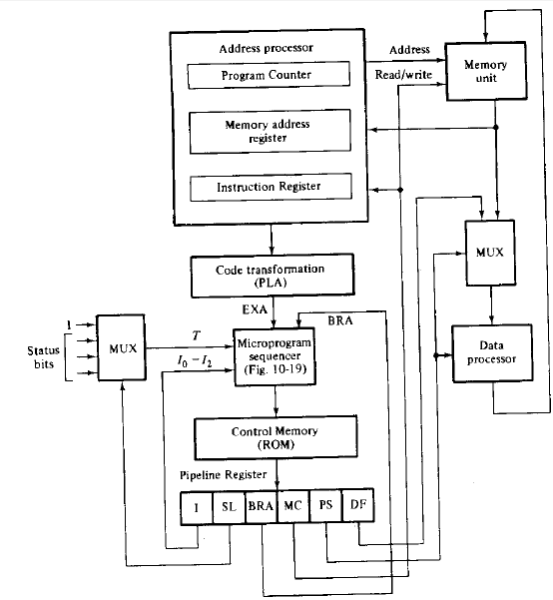

Microprogrammed CPU organization

